Slide 1
XML
Extensible Markup Language

Slide 2
What is XML
XML stands for eXtensible Markup Language.
A markup language is used to provide information about a document.
Tags are added to the document to provide the extra information.
HTML tags tell a browser how to display the document.
XML tags give a reader some idea what some of the data means.

Slide 3
XML is not…
A replacement for HTML
(but HTML can be generated from XML)
A presentation format
(but XML can be converted into one)
A programming language
(but it can be used with almost any language)
A network transfer protocol
(but XML may be transferred over a network)
A database
(but XML may be stored into a database)

Slide 4
But then – what is it?
XML is a meta markup language for text documents / textual data
XML allows to define languages („applications“) to represent text documents / textual data

Slide 5
Possible Advantages of Using XML
Truly Portable Data
Easily readable by human users
Very expressive (semantics near data)
Very flexible and customizable (no finite tag set)
Easy to use from programs (libs available)
Easy to convert into other representations
(XML transformation languages)
Many additional standards and tools
Widely used and supported

Slide 6
Example of an HTML Document
<html>
<head>
<title>Example</title>
</head
<body>
<h1>This is an example of a page.</h1>
<h2>Some information goes here.</h2>
</body>
</html>

Slide 7
XML by Example
<article>
<author>Gerhard Weikum</author>
<title>The Web in 10 Years</title>
</article>
Easy to understand for human users
Very expressive (semantics along with the data)
Well structured, easy to read and write from programs
This looks nice, but…

Slide 8
XML by Example
… this is XML, too:
<t108>
<x87>Gerhard Weikum</x87>
<g10>The Web in 10 Years</g10>
</t108>
Hard to understand for human users
Not expressive (no semantics along with the data)
Well structured, easy to read and write from programs

Slide 9
XML by Example
… and what about this XML document:
<data>
ch37fhgks73j5mv9d63h5mgfkds8d984lgnsmcns983
</data>
Impossible to understand for human users
Not expressive (no semantics along with the data)
Unstructured, read and write only with special programs
The actual benefit of using XML highly depends on the design of the application.

Slide 10
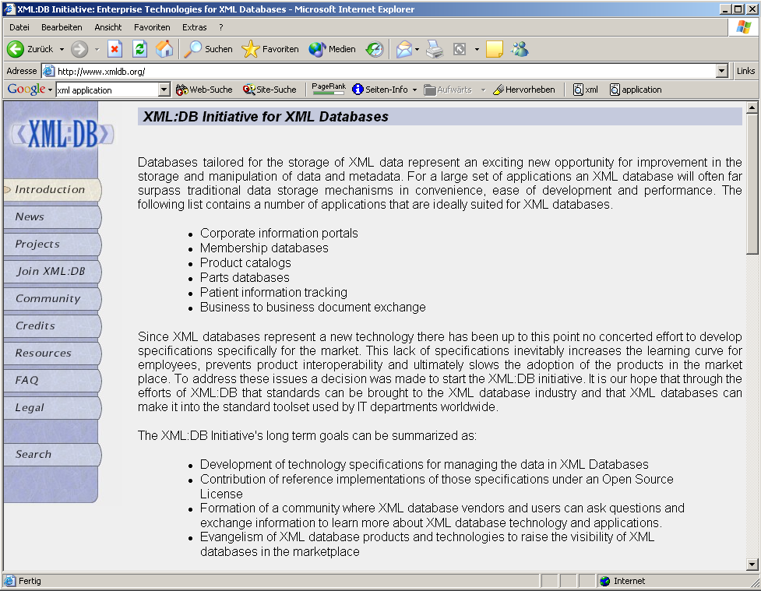



App. Scenario 1: Content Mgt.
Clients
XML2HTML
XML2WML
XML2PDF
Converters
Database with XML documents

Slide 11
App. Scenario 2: Data Exchange
Buyer
Supplier
XML Adapter
XML
XML Adapter
(BMECat, ebXML, RosettaNet, BizTalk, …)
Legacy System (e.g., SAP R/2)
Legacy System (e.g., Cobol)
Order

Slide 12
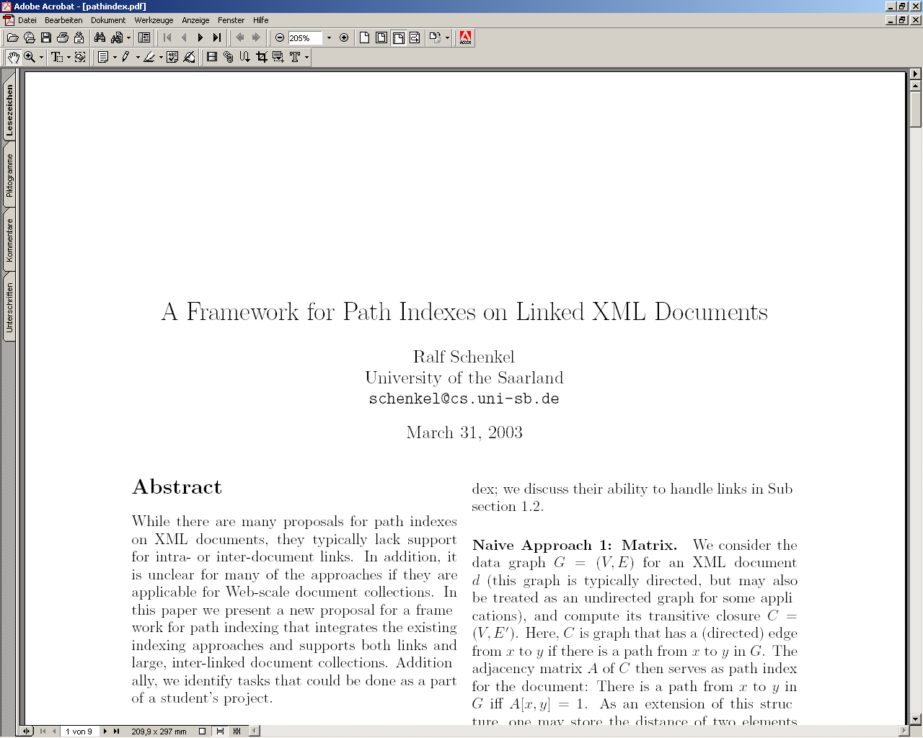
App. Scenario 3: XML for Metadata
<rdf:RDF
<rdf:Description rdf:about="http://www-dbs/Sch03.pdf">
<dc:title>A Framework for…</dc:title>
<dc:creator>Ralf Schenkel</dc:creator>
<dc:description>While there are...</dc:description>
<dc:publisher>Saarland University</dc:publisher>
<dc:subject>XML Indexing</dc:subject>
<dc:rights>Copyright ...</dc:rights>
<dc:type>Electronic Document</dc:type>
<dc:format>text/pdf</dc:format>
<dc:language>en</dc:language>
</rdf:Description>
</rdf:RDF>

Slide 13
XML Documents
What‘s in an XML document?
Elements
Attributes
plus some other details
(see the Lecture if you want to know this)

Slide 14
A Simple XML Document
<article>
<author>Gerhard Weikum</author>
<title>The Web in Ten Years</title>
<text>
<abstract>In order to evolve...</abstract>
<section number=“1” title=“Introduction”>
The <index>Web</index> provides the universal...
</section>
</text>
</article>

Slide 15
A Simple XML Document
<article>
<author>Gerhard Weikum</author>
<title>The Web in Ten Years</title>
<text>
<abstract>In order to evolve...</abstract>
<section number=“1” title=“Introduction”>
The <index>Web</index> provides the universal...
</section>
</text>
</article>
Freely definable tags

Slide 16
A Simple XML Document
Start Tag
<article>
<author>Gerhard Weikum</author>
<title>The Web in Ten Years</title>
<text>
<abstract>In order to evolve...</abstract>
<section number=“1” title=“Introduction”>
The <index>Web</index> provides the universal...
</section>
</text>
</article>
Content of the Element (Subelements and/or Text)
End Tag
Element

Slide 17
A Simple XML Document
<article>
<author>Gerhard Weikum</author>
<title>The Web in Ten Years</title>
<text>
<abstract>In order to evolve...</abstract>
<section number=“1” title=“Introduction”>
The <index>Web</index> provides the universal...
</section>
</text>
</article>
Attributes with name and value

Slide 18
Elements in XML Documents
(Freely definable) tags: article, title, author
  with start tag: <article> etc.
  and end tag: </article> etc.
Elements: <article> ... </article>
Elements have a name (article) and a content (...)
Elements may be nested.
Elements may be empty: <this_is_empty/>
Element content is typically parsed character data (PCDATA), i.e., strings with special characters, and/or nested elements (mixed content if both).
Each XML document has exactly one root element and forms a tree.
Elements with a common parent are ordered.

Slide 19
Elements vs. Attributes
Elements may have attributes (in the start tag) that have a name and
a value, e.g. <section number=“1“>.
What is the difference between elements and attributes?
Only one attribute with a given name per element (but an arbitrary number of subelements)
Attributes have no structure, simply strings (while elements can have subelements)
As a rule of thumb:
Content into elements
Metadata into attributes
Example:
<person born=“1912-06-23“ died=“1954-06-07“>
Alan Turing</person> proved that…

Slide 20
XML Documents as Ordered Trees
article
author
title
text
number=“1“
abstract
section
Gerhard Weikum
title=“…“
In order …
The
index
provides …
The Web in 10 years
Web

Slide 21
More on XML Syntax
Some special characters must be escaped using entities:
< → &lt;
& → &amp;
(will be converted back when reading the XML doc)
Some other characters may be escaped, too:
> → &gt;
“ → &quot;
‘ → &apos;

Slide 22
Well-Formed XML Documents
A well-formed document must adher to, among others, the following rules:
Every start tag has a matching end tag.
Elements may nest, but must not overlap.
There must be exactly one root element.
Attribute values must be quoted.
An element may not have two attributes with the same name.
Comments and processing instructions may not appear inside tags.
No unescaped < or & signs may occur inside character data.

Slide 23
Well-Formed XML Documents
A well-formed document must adher to, among others, the following rules:
Every start tag has a matching end tag.
Elements may nest, but must not overlap.
There must be exactly one root element.
Attribute values must be quoted.
An element may not have to attributes with the same name.
Comments and processing instructions may not appear inside tags.
No unescaped < or & signs may occur inside character data.
Only well-formed documents can be processed by XML parsers.

Slide 24
2.3 Namespaces
<library>
<description>Library of the CS Department</description>
<book bid=“HandMS2000“>
<title>Principles of Data Mining</title>
<description>
Short introduction to <em>data mining</em>, useful
for the IRDM course
</description>
</book>
</library>
Semantics of the description element is ambigous
Content may be defined differently
Renaming may be impossible (standards!)
⇒ Disambiguation of separate XML applications using unique prefixes

Slide 25
Namespace Syntax
<dbs:book xmlns:dbs=“http://www-dbs/dbs“>
Prefix as abbrevation of URI
Unique URI to identify the namespace
Signal that namespace definition happens

Slide 26
Namespace Example
<dbs:book xmlns:dbs=“http://www-dbs/dbs“>
<dbs:description> ... </dbs:description>
<dbs:text>
<dbs:formula>
<mathml:math xmlns:mathml=“http://www.w3.org/1998/Math/MathML“>
...
</mathml:math>
</dbs:formula>
</dbs:text>
</dbs:book>

Slide 27
Default Namespace
Default namespace may be set for an element and its content (but not its attributes):
  <book xmlns=“http://www-dbs/dbs“>
  <description>...</description>
  <book>
Can be overridden in the elements by specifying the namespace there (using prefix or default namespace)

Slide 28
3.1 Document Type Definitions
Sometimes XML is too flexible:
Most Programs can only process a subset of all possible XML applications
For exchanging data, the format (i.e., elements, attributes and their semantics) must be fixed
Document Type Definitions (DTD) for establishing the vocabulary for one XML application (in some sense comparable to schemas in databases)
A document is valid with respect to a DTD if it conforms to the rules specified in that DTD.
Most XML parsers can be configured to validate.

Slide 29
DTD Example: Elements
<!ELEMENT article (title,author+,text)>
<!ELEMENT title (#PCDATA)>
<!ELEMENT author (#PCDATA)>
<!ELEMENT text (abstract,section*,literature?)>
<!ELEMENT abstract (#PCDATA)>
<!ELEMENT section (#PCDATA|index)+>
<!ELEMENT literature (#PCDATA)>
<!ELEMENT index (#PCDATA)>
Content of the text element may contain zero or more section elements in this position
Content of the title element is parsed character data
Content of the article element is a title element, followed by one or more author elements,
followed by a text element

Slide 30
Element Declarations in DTDs
One element declaration for each element type:
<!ELEMENT element_name content_specification>
where content_specification can be
(#PCDATA) parsed character data
(child) one child element
(c1,…,cn) a sequence of child elements c1…cn
(c1|…|cn) one of the elements c1…cn
For each component c, possible counts can be specified:
  c exactly one such element
  c+ one or more
  c* zero or more
  c? zero or one
Plus arbitrary combinations using parenthesis:
<!ELEMENT f ((a|b)*,c+,(d|e))*>

Slide 31
More on Element Declarations
Elements with mixed content:
  <!ELEMENT text (#PCDATA|index|cite|glossary)*>
Elements with empty content:
  <!ELEMENT image EMPTY>
Elements with arbitrary content (this is nothing for production-level DTDs):
  <!ELEMENT thesis ANY>

Slide 32
Attribute Declarations in DTDs
Attributes are declared per element:
<!ATTLIST section number CDATA #REQUIRED
title CDATA #REQUIRED>
declares two required attributes for element section.
element name
attribute name
attribute type
attribute default

Slide 33
Attribute Declarations in DTDs
Attributes are declared per element:
<!ATTLIST section number CDATA #REQUIRED
title CDATA #REQUIRED>
declares two required attributes for element section.
Possible attribute defaults:
#REQUIRED is required in each element instance
#IMPLIED is optional
#FIXED default always has this default value
default has this default value if the attribute is
omitted from the element instance

Slide 34
Attribute Types in DTDs
CDATA string data
(A1|…|An) enumeration of all possible values of the
attribute (each is XML name)
ID unique XML name to identify the element
IDREF refers to ID attribute of some other element
(„intra-document link“)
IDREFS list of IDREF, separated by white space
plus some more

Slide 35
Attribute Examples
<ATTLIST publication type (journal|inproceedings) #REQUIRED
pubid ID #REQUIRED>
<ATTLIST cite cid IDREF #REQUIRED>
<ATTLIST citation ref IDREF #IMPLIED
cid ID #REQUIRED>
<publications>
<publication type=“journal“ pubid=“Weikum01“>
<author>Gerhard Weikum</author>
<text>In the Web of 2010, XML <cite cid=„12“/>...</text>
<citation cid=„12“ ref=„XML98“/>
<citation cid=„15“>...</citation>
</publication>
<publication type=“inproceedings“ pubid=“XML98“>
<text>XML, the extended Markup Language, ...</text>
</publication>
</publications>

Slide 36
Attribute Examples
<ATTLIST publication type (journal|inproceedings) #REQUIRED
pubid ID #REQUIRED>
<ATTLIST cite cid IDREF #REQUIRED>
<ATTLIST citation ref IDREF #IMPLIED
cid ID #REQUIRED>
<publications>
<publication type=“journal“ pubid=“Weikum01“>
<author>Gerhard Weikum</author>
<text>In the Web of 2010, XML <cite cid=„12“/>...</text>
<citation cid=„12“ ref=„XML98“/>
<citation cid=„15“>...</citation>
</publication>
<publication type=“inproceedings“ pubid=“XML98“>
<text>XML, the extended Markup Language, ...</text>
</publication>
</publications>

Slide 37
Linking DTD and XML Docs
Document Type Declaration in the XML document:
  <!DOCTYPE article SYSTEM “http://www-dbs/article.dtd“>
keywords
Root element
URI for the DTD

Slide 38
Linking DTD and XML Docs
Internal DTD:
  <?xml version=“1.0“?>
  <!DOCTYPE article [
  <!ELEMENT article (title,author+,text)>
  ...
  <!ELEMENT index (#PCDATA)>
  ]>
  <article>
  ...
  </article>
Both ways can be mixed, internal DTD overwrites external entity information:
  <!DOCTYPE article SYSTEM „article.dtd“ [
  <!ENTITY % pub_content (title+,author*,text)
  ]>

Slide 39
Flaws of DTDs
No support for basic data types like integers, doubles, dates, times, …
No structured, self-definable data types
No type derivation
id/idref links are quite loose (target is not specified)
⇒ XML Schema

Slide 40
3.2 XML Schema Basics
XML Schema is an XML application
Provides simple types (string, integer, dateTime, duration, language, …)
Allows defining possible values for elements
Allows defining types derived from existing types
Allows defining complex types
Allows posing constraints on the occurrence of elements
Allows forcing uniqueness and foreign keys
Way too complex to cover in an introductory talk

Slide 41
Simplified XML Schema Example
<xs:schema>
<xs:element name=“article“>
<xs:complexType>
<xs:sequence>
<xs:element name=“author“ type=“xs:string“/>
<xs:element name=“title“ type=“xs:string“/>
<xs:element name=“text“>
<xs:complexType>
<xs:sequence>
<xs:element name=“abstract“ type=“xs:string“/>
<xs:element name=“section“ type=“xs:string“
minOccurs=“0“ maxOccurs=“unbounded“/>
</xs:sequence>
</xs:complexType>
</xs:element>
</xs:sequence>
</xs:complexType>
</xs:element>
</xs:schema>

